Slide 1
2012_10_12_labmeeting

Slide 2
Cobalt
T0, A0
T2, A2
From left 10 cm~90 cm scan.

Slide 3
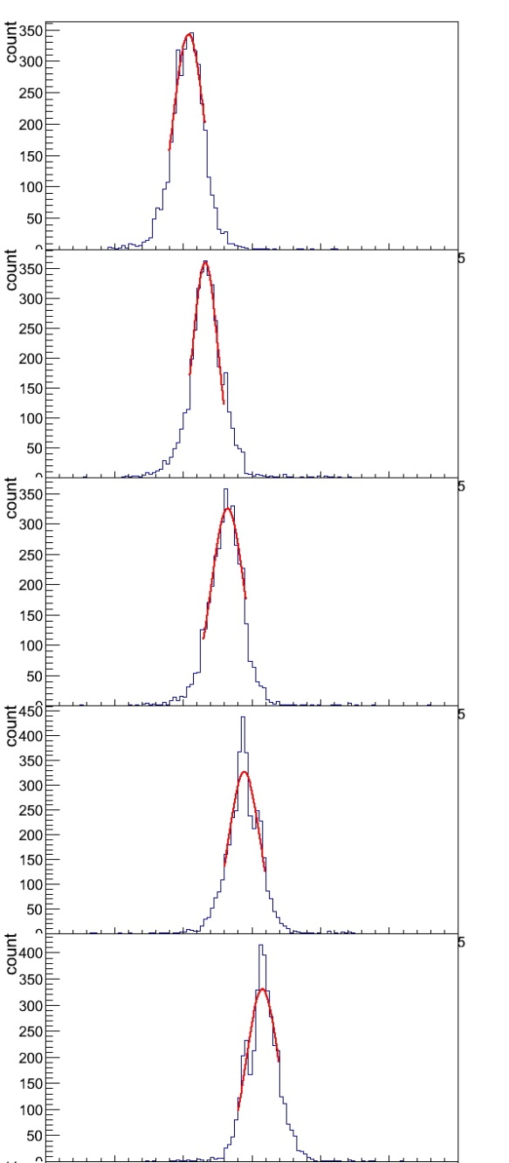
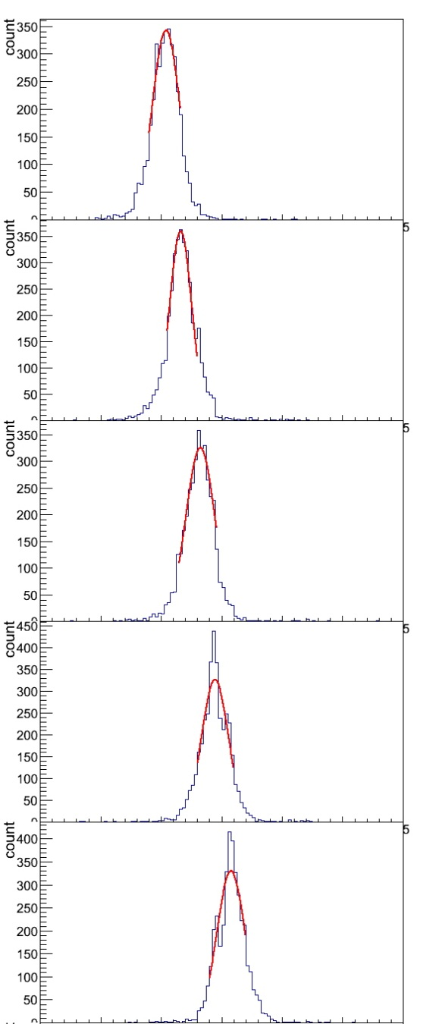
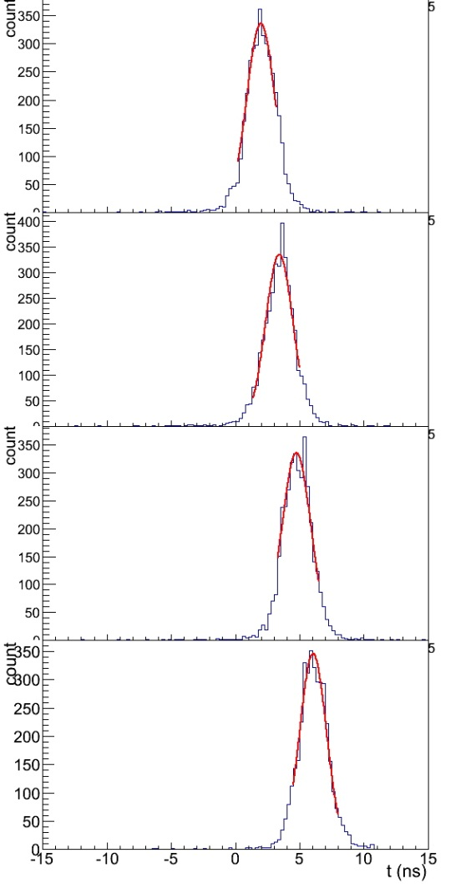
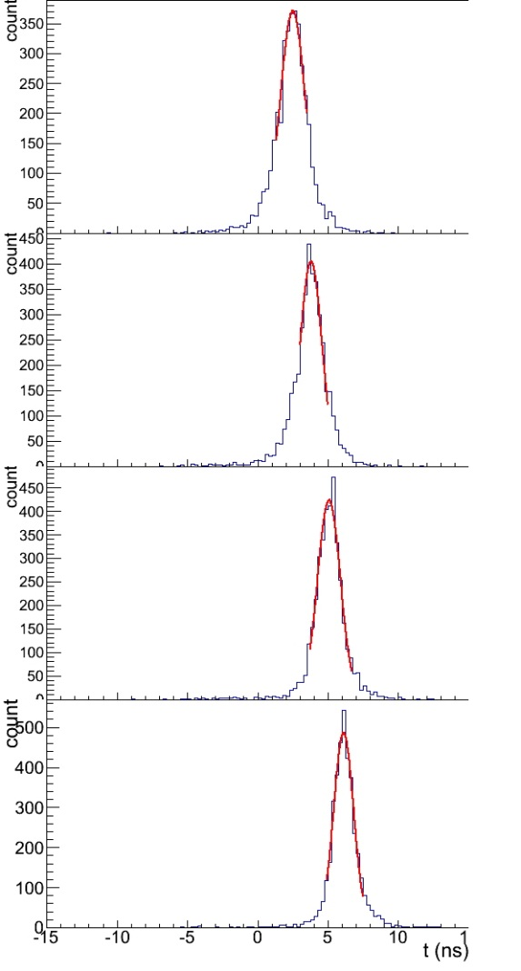
T0-T2
10 cm
VTD
10 cm
CFD
90 cm
90 cm

Slide 4
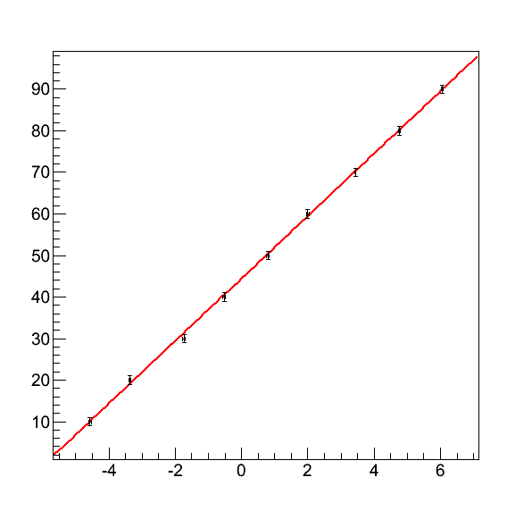
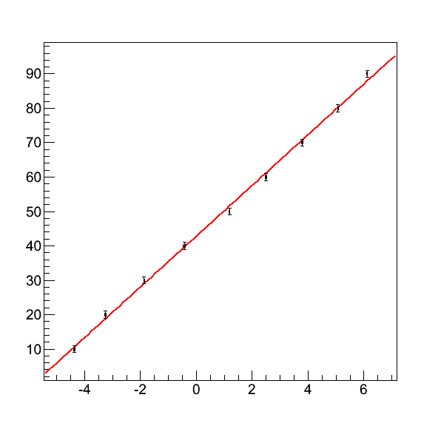
Position function
VTD
CFD
$x=\left(7.51701±0.0996423\right)∆t+33.2839±0.251487$
$x=\left(7.38725±0.0966829\right)∆t+42.8135+0.351971$

Slide 5
Error bar
Now using parameter error of T0-T2
Other candidates are sigma and combination of sigma of T0, T2

Slide 6
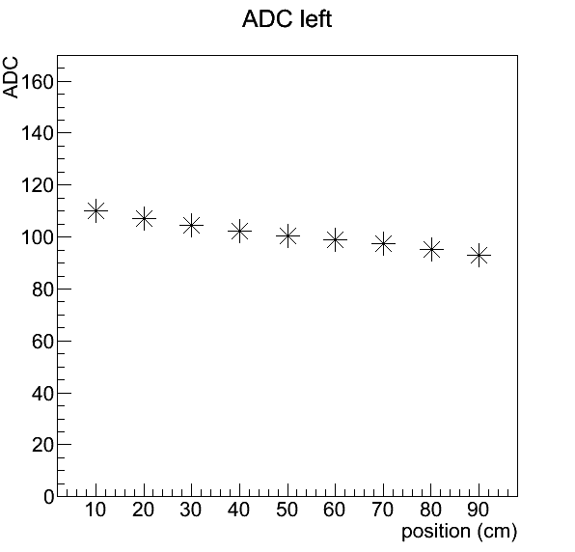
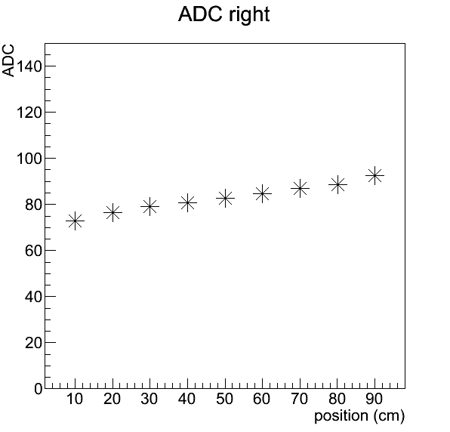
ADC (VTD)

Slide 7
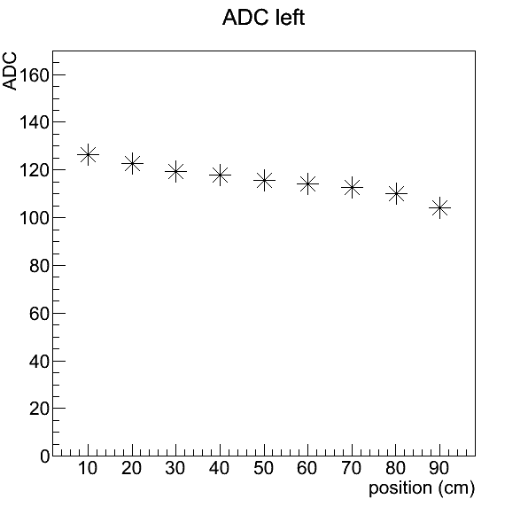
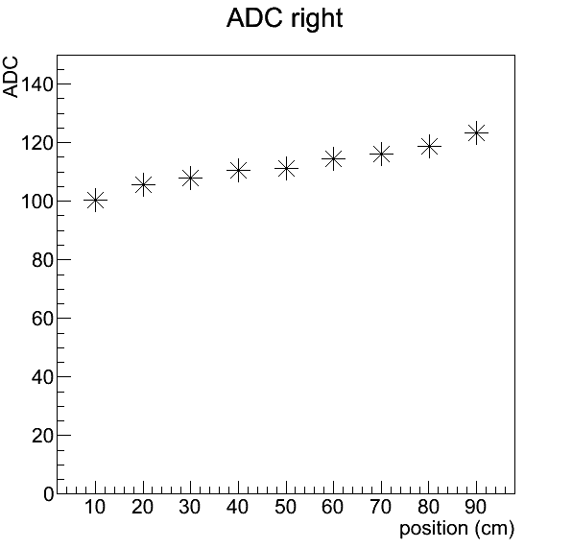
ADC (CFD)

Slide 8
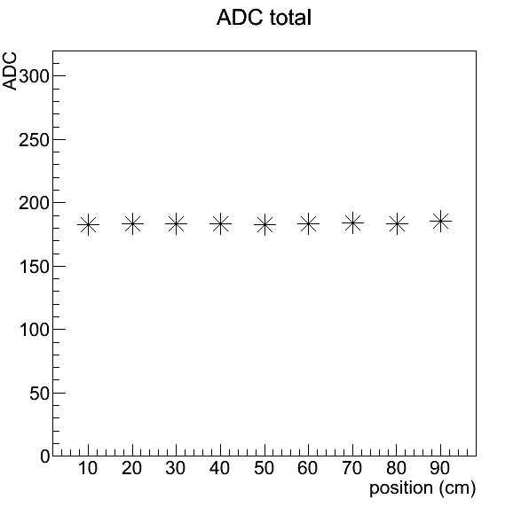
ADC (A0+A2)
VTD
CFD

Slide 9
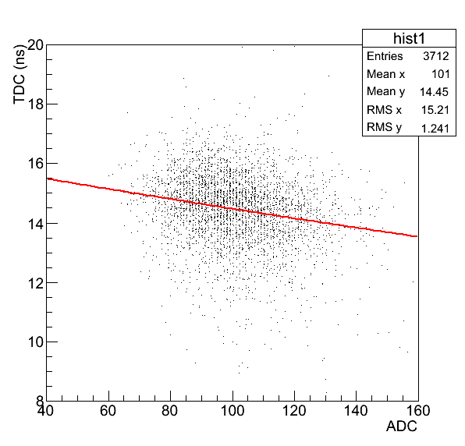
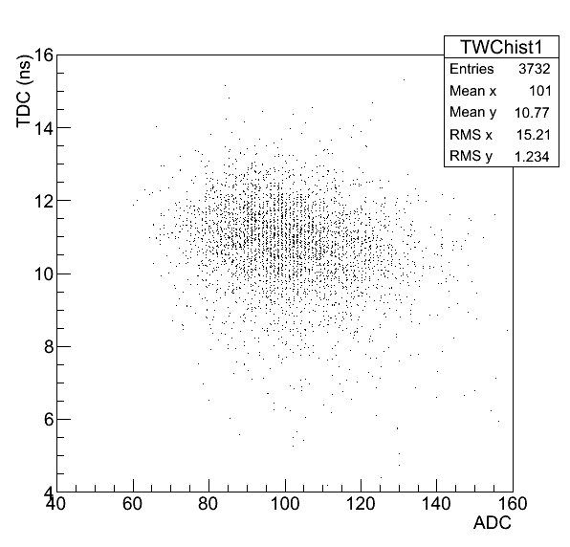
Time Walk Correction(VTD)
Exponential fit. $\sqrt{\frac{ℵ^{2}}{NDF}}=16.90157$

Slide 10
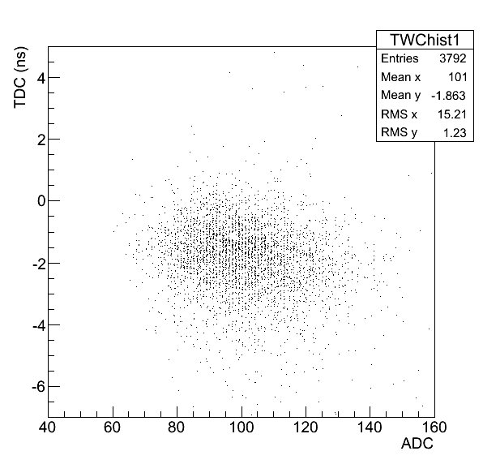
Time Walk Correction(VTD)
1st order polynomial fit. $\sqrt{\frac{ℵ^{2}}{NDF}}=16.90113$

Slide 11
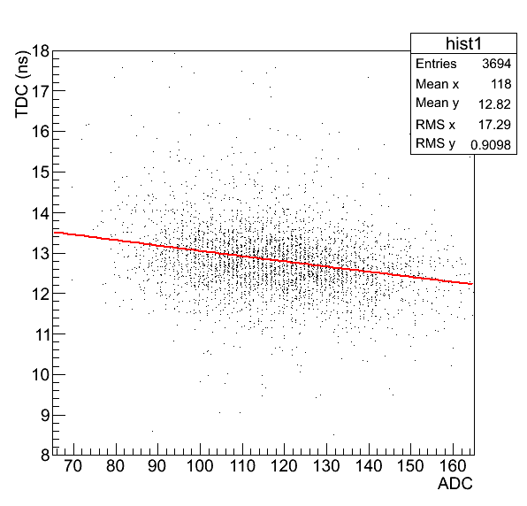
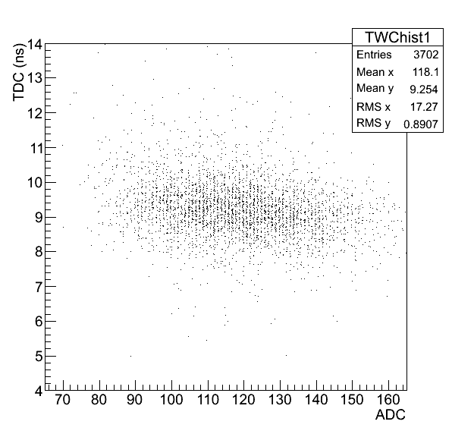
Time Walk Correction(CFD)
Exponential fit. $\sqrt{\frac{ℵ^{2}}{NDF}}=12.86456$

Slide 12
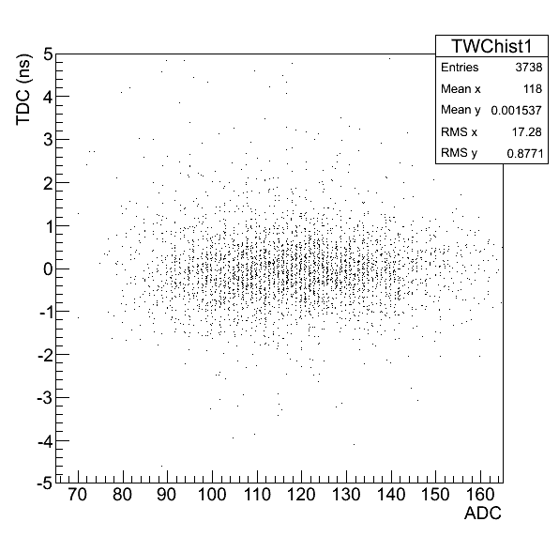
Time Walk Correction(CFD)
1st order polynomial fit. $\sqrt{\frac{ℵ^{2}}{NDF}}=12.86611$

Slide 13
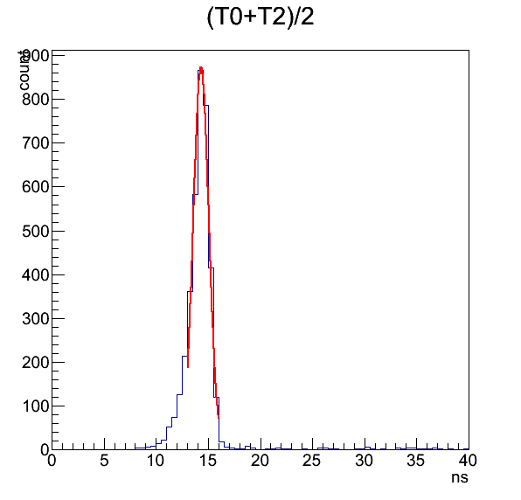
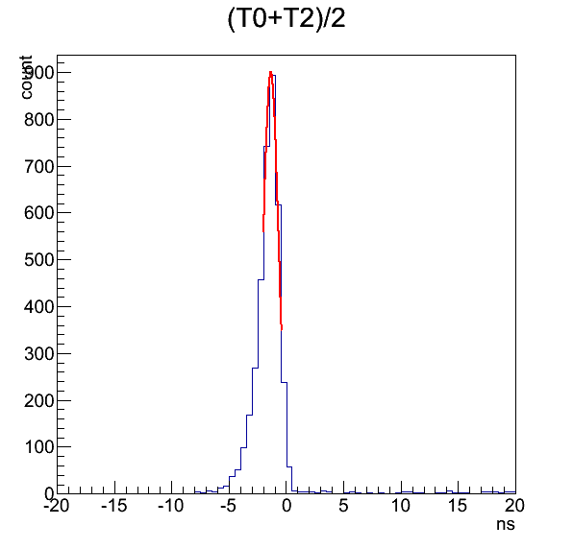
Resolution(VTD)
Before correction
After correction
$σ=0.745772$
$σ=0.672951$

Slide 14
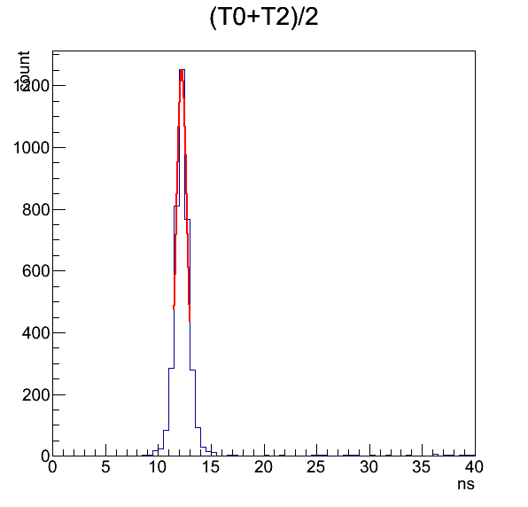
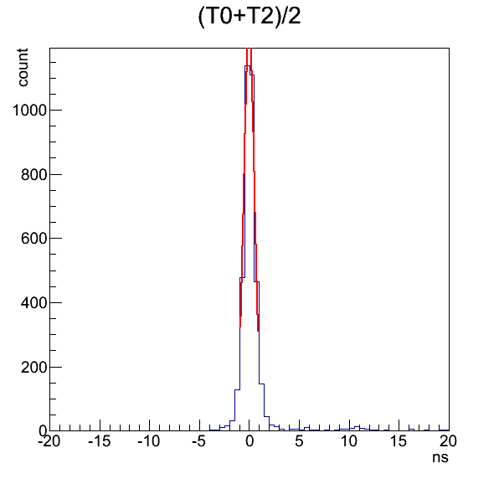
Resolution(CFD)
Before correction
After correction
$σ=0.520565$
$σ=0.536875$

Slide 15
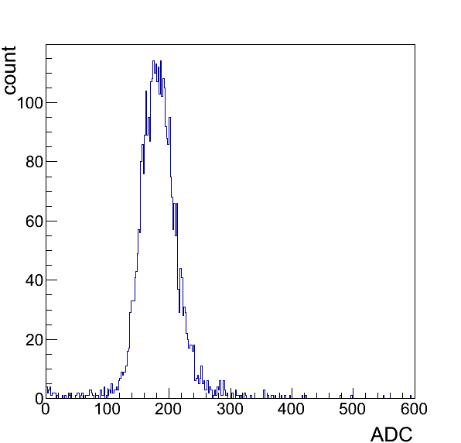
Compton edge(VTD)
Compton edge: 220
Threshold: 145->685 keV
Electron equivalent threshold: 342 keV
Compton edge of γ from ⁶⁰Co: 1.04 MeV

Slide 16
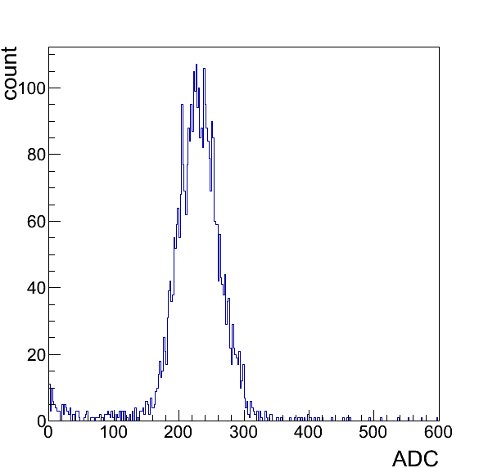
Compton edge(CFD)
Compton edge: 270
Threshold: 185->712 keV
Electron equivalent threshold: 356 keV
Compton edge of γ from ⁶⁰Co: 1.04 MeV

Slide 17
Californium
T0, A0
T2, A2
1 m

Slide 18
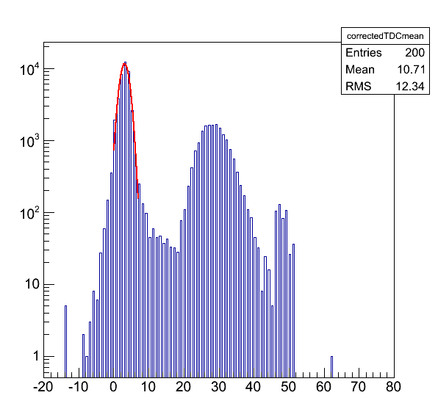
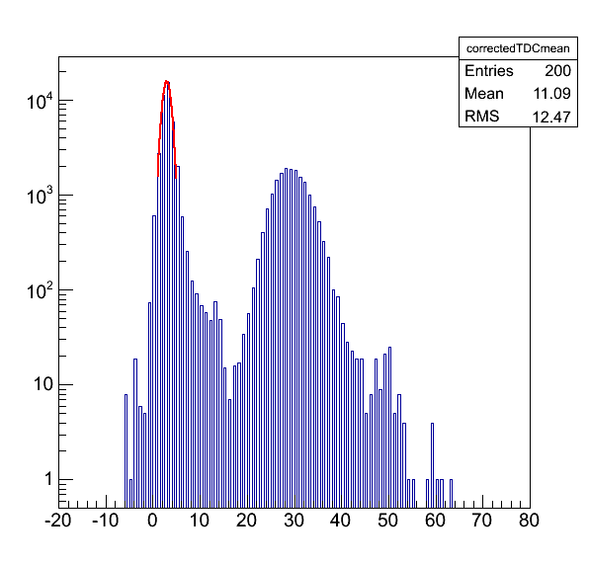
(T0+T2)/2
VTD
CFD
γ
γ
n
n

Slide 19
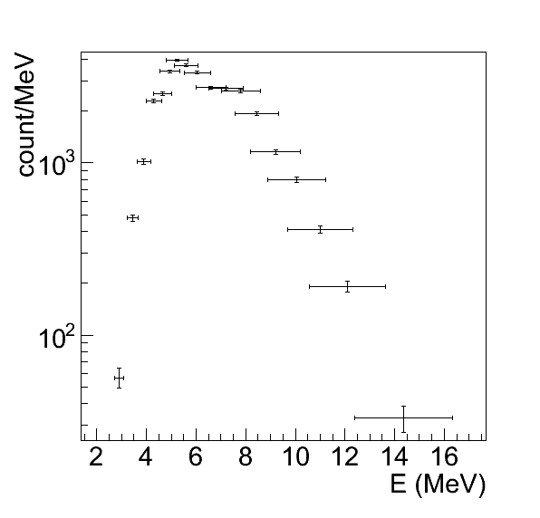
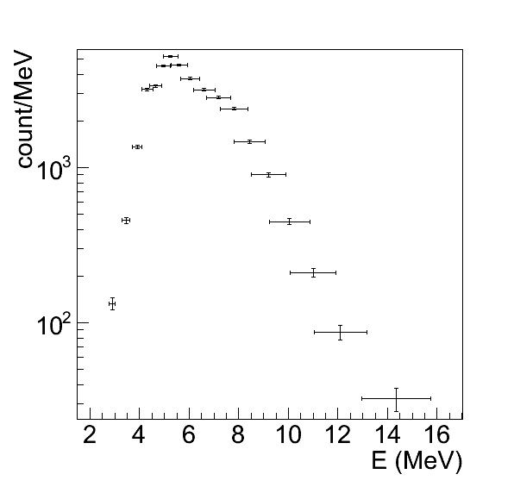
Neutron energy
VTD
CFD
19~42 ns
17~44 ns

