Slide 1
Development of beam tracking detector using MicroChannel Plate(MCP)
2012. 12. 15
Chung-Ang Univ.
Il Maek Lee

Slide 2
Outline.
Introduction
Research goal
Research contents and methods
Research schedule
Current progress
Summary

Slide 3
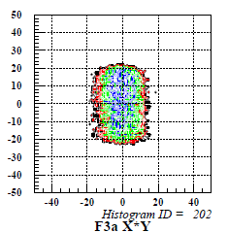
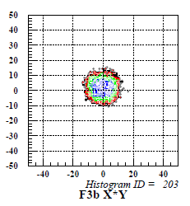
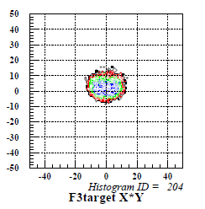
Introduction
Case of In-Flight RI Beam with relatively large Beam emittance,
each heavy ion particle trajectory tracking is needed.
Install the detector at each point to obtain 2-dimensional information.
Contribution of the particle trajectory and the beam profile monitor using a 2-demension information.
Z₁
Z₂
detector 1
detector 2
Target
(X_{1,} Y₁)
(X_{2,} Y₂)
Target size

Slide 4
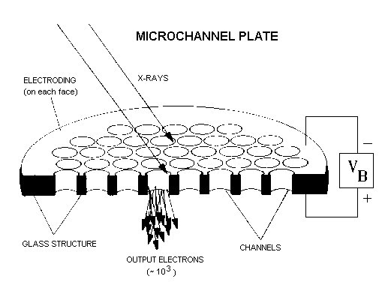
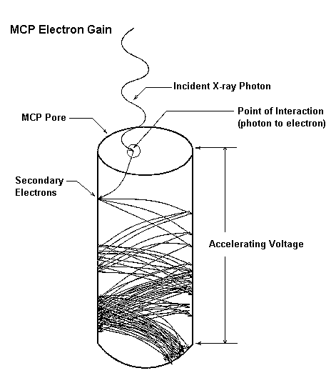
Introduction
About MCP.
MCP is made by thin tube that has diameter 10㎛ in circular shape.
Incident electrons generate secondary electrons by collision on the wall of channel. Secondary electrons collide again. Signal is amplified by this processes.
In general we obtain amplified signal with 10³~10⁵ times.

Slide 5
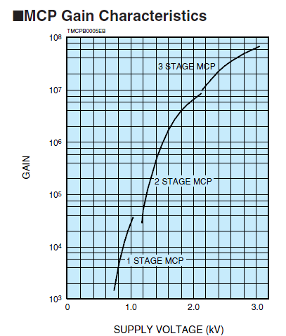
Introduction
About MCP.
In general Electrons, ion, UV ray, X-ray, and γ-ray detection use MCP.
Used to connect the 1~3 MCP to obtain the desired gain.
MCP is small energy loss and no background because of thinner than the thickness of the PPAC. So suitable Low energy Heavy ion experiment.

Slide 6
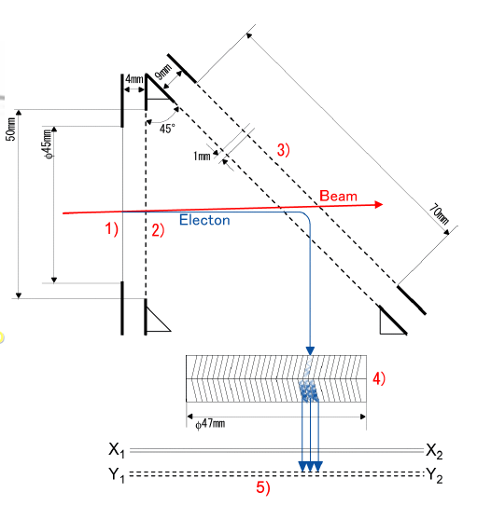
Introduction
Hayakawa Model
Efficiency :
³⁶Ar : 100 % @ < 5 kHz
¹¹C : > 96 % @ 500kHz
¹⁸F : > 80 % @ 700kHz, > 55% @ 1MHz
Position resol : X - 1.2 ± 0.1 mm (FWHM) Y - 2.8 ± 0.1 mm (FWHM)
Time resol : 0.7 ~ 0.8 ns
Position resolution is bad because of reflector structure

Slide 7
Research goal
Expected beam conditions. a. Intensity > 10⁶pps b. Purity ~ 100% c. E/A ≤ 18 MeV
MCP : Efficiency : 100% (E < 10MeV/u, Z/A < 0.6)
Position resol. : < 1mm (FWHM)
Time resol. : < 1 ns (FWHM)

Slide 8
Research contents and methods
Previous research
Simulation
Prototype manufacturing
Beam test using a radioactive source and the domestic and international facilities
Optimized design values obtain and apply
Design

Slide 9
Research schedule
 | Sep | Oct | Nov | Dec | Jan | Feb | Mar | Apr | May
Previous Research
Simulation
Prototype Manufacturing / Optimization
Design

Slide 10
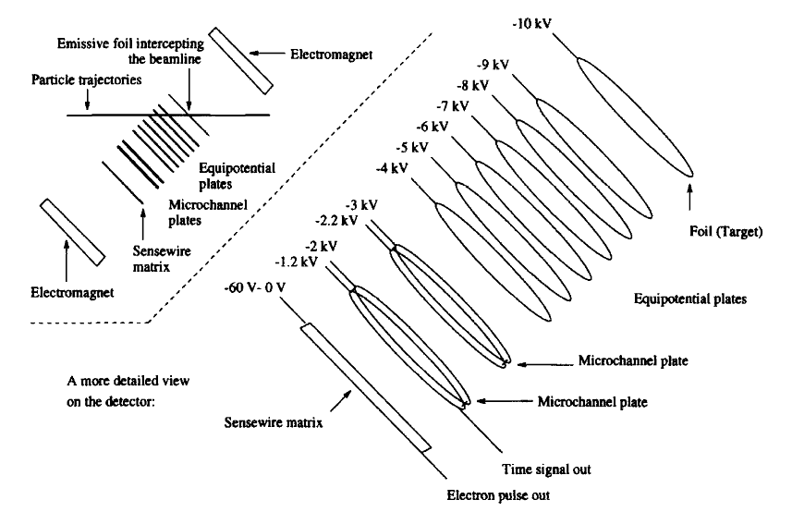
Current progress
GANIL Model
The best efficiency : 200~500eV
The best acceleration potential : 100~400V
Efficiency : near 100%
(E>50MeV/nucleon, Z>8)
Position resol : > 0.2mm
Time resol : 200~300ps

Slide 11
Current progress
GANIL Model
Lorentz force
Electron
ρ
r
θ
One hole of the MCP
O
r-rcosθ
rsinθ

Slide 12
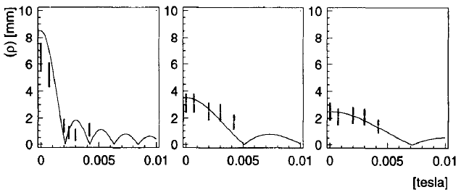
Current progress
GANIL Model
d : distance of foil~sensewire
B : intensity of b-field
Vacc : acceleration of equipotential

Slide 13
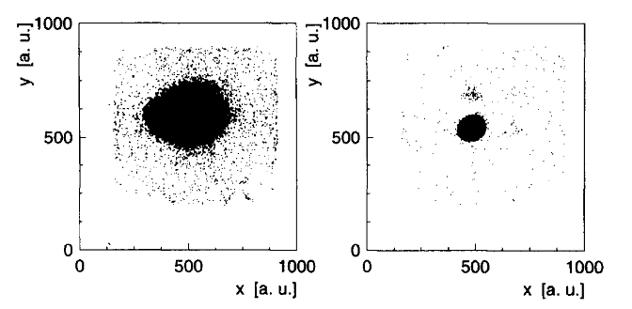
Current progress
GANIL Model
Improve position resolution using B-field
E=4000V/m, without B-field
E=4000V/m, B=3.0mT
Beam monitoring area is smaller than MCP size because of oblique structure.

Slide 14
Current progress
Design concept for Simulation
Beam
Electron
Equipotential plates
MCP
Electromagnet
Sensewire matrix
E-field
B-field

Slide 15
Current progress
Design concept for Simulation
n = 2
d = 0.025m >> 25mm
Vacc = 2000V
B = 0.003T >> 3mT

Slide 16
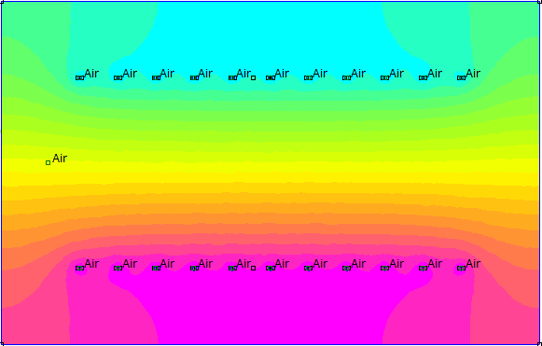
Current progress
Design E-field using FEMM
wire diameter : 1um
wire spacing : 5mm

Slide 17
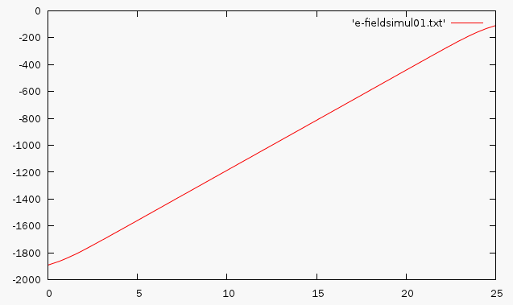
Current progress
Design E-field using FEMM
V = -1900V~-100V

Slide 18
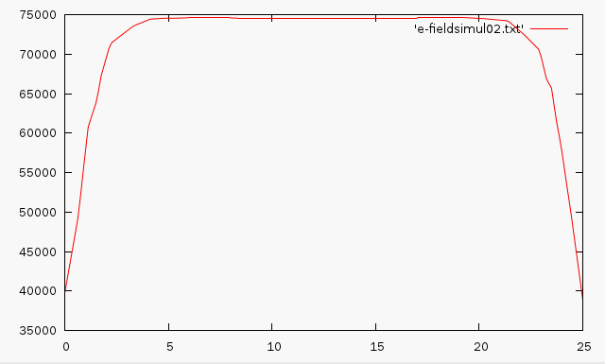
Current progress
Design E-field using FEMM
|E| = 74500 V/m

Slide 19
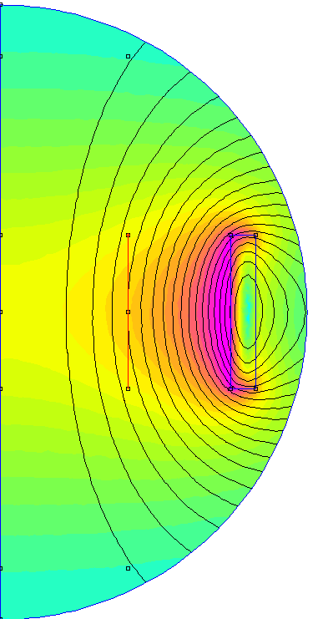
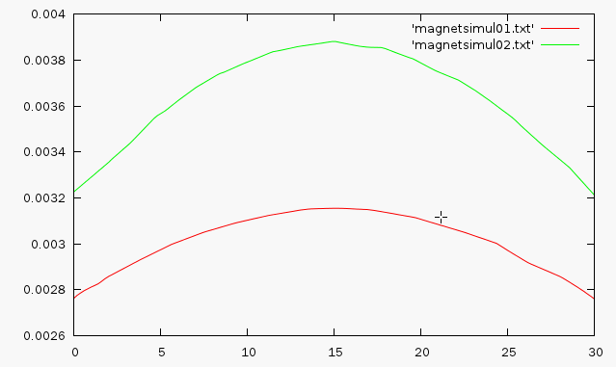
Current progress
Design B-field using FEMM
Copper 18 AWG
Coil : 500
Current : 0.5Amps
Center : 2.8mT~3.15mT
Side : 3.2mT~3.85mT

Slide 20
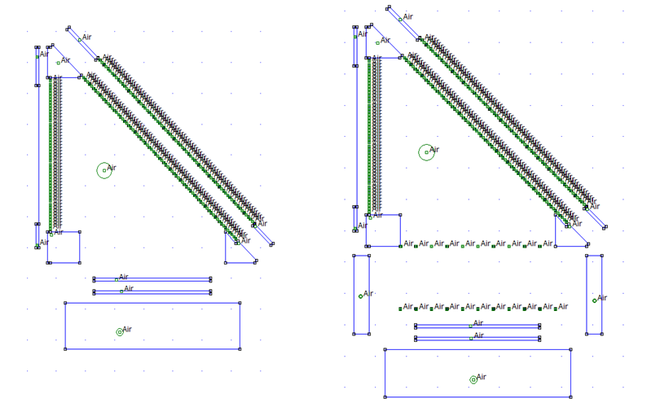
Current progress
Simulate using FEMM

Slide 21
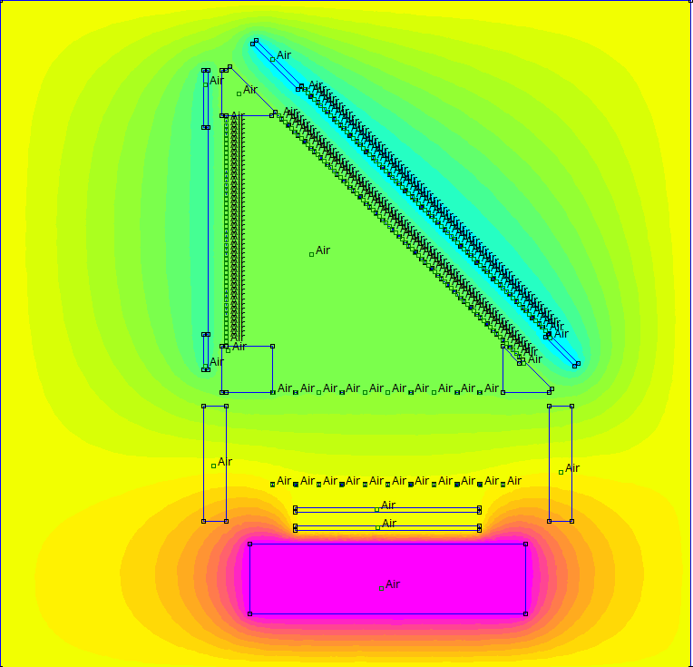
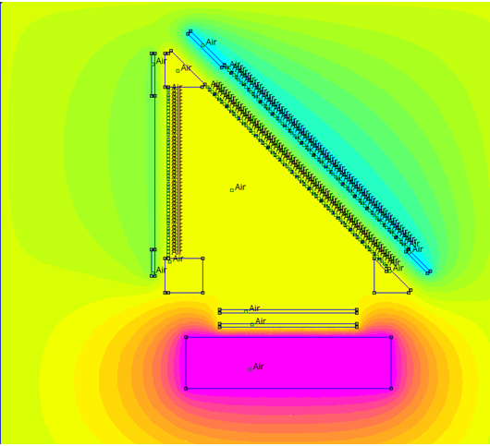
Current progress
Simulate using FEMM

Slide 22
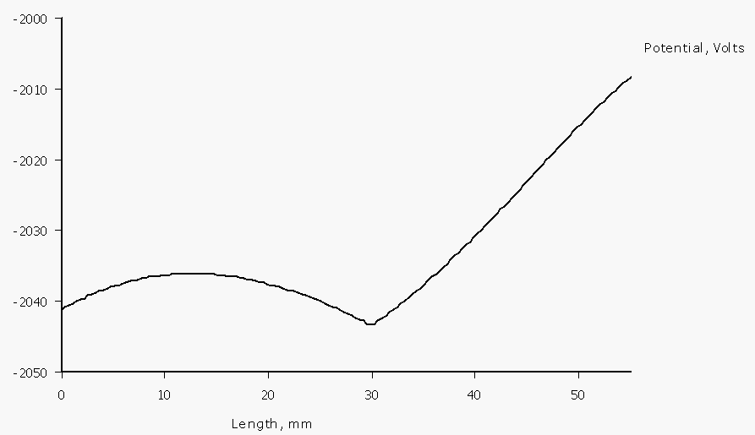
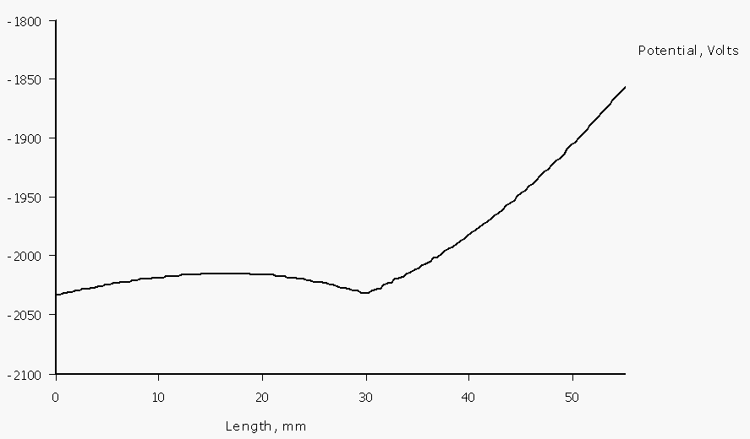
Current progress
Simulate using FEMM
No wire
-2041V ~ -2036V
-2042V ~ -2008V
Wire
-2035V ~ -2025V
-2040V ~ -1850V

Slide 23
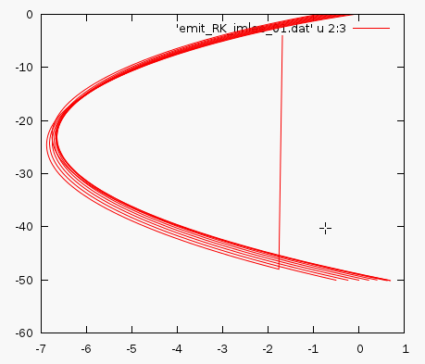
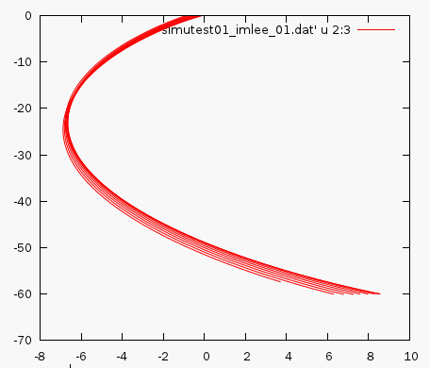
Current progress
Simulate using octaveFEMM
y : -50
X range : -1 ~ 1
y : -50
X range : -0.5 ~ 1.5

Slide 24
Current progress
Limit of FEMM
Problem solves magnetic or electrostatic.
Planar or axisymmetric.
limit of 2-dimension problem.
Lorentz force is 3-dimension problem.
Need to solve the electrostatic and magnetic at the same time and to support 3-dimension problem.

Slide 25
Current progress
Conclusions
Acceleration potential is positive.
The results obtained use to design.
Add B-field in this concept design.
3-dimension simulate using MAFIA
EM-field simulation.

Slide 26
Summary
Case of In-Flight RI Beam each heavy ion particle trajectory tracking is needed.
MCP is small energy loss and no background.
Hayakawa model’s position resolution is bad.
B-field improve position resolution in GANIL model.
Concept design using femm and simulate using octave.
Add B-field in obtained result.
3-dimension simulation with MAFIA.

