Slide 1
Charged particle detection system
- Silicon array development -
2012. 12. 15
Jun Young, Moon
IIFI, Chung-Ang univ.

Slide 2
Time table for development
 | Sep. | Oct. | Nov. | Dec. | Jan. | Feb. | Mar. | Apr. | Etc.
Review on other developments ( Figure-out of design factors ) |  |  |  |  |  |  |  |  | TIARA (GANIL) ORRU-BA (ORNL)
Preliminary calculation (Basic information for MC simul.) |  |  |  |  |  |  |  |  | FRES-CO, LISE++
Specific parameters taken from MC simulation |  |  |  |  |  |  |  |  | GEANT4
CAD-Drawing
Now

Slide 3

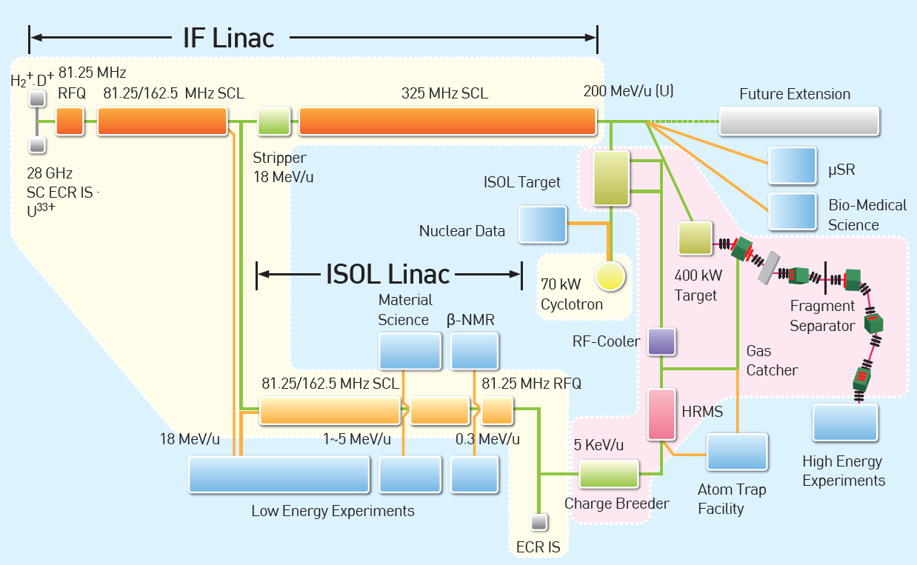
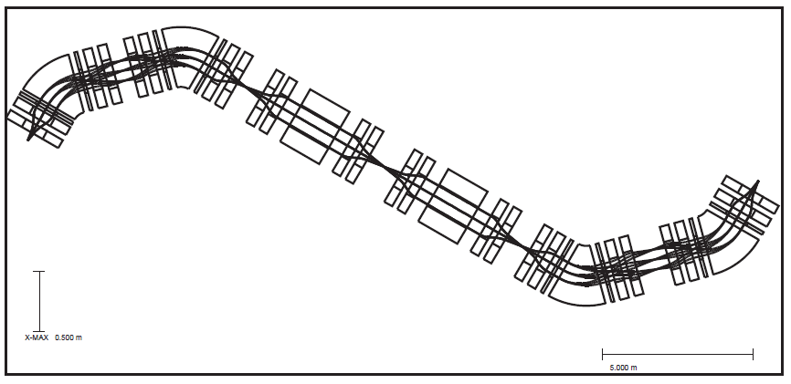
Nuclear physics with Recoil Spectrometer @ RAON
Low energy nuclear astrophysics : E _{beam} < 18 MeV/u
H-, or He-Burning thermonuclear reactions, CNO cycle, HCNO cycle,
rp-process, s-process, r-process
Direct or Indirect method (elastic scattering, transfer reaction, ANC,…)
[ A schematic view of RAON ]
[ Recoil spectrometer ]
Wien Filter
F0
F1
F2
F6
F3
F5
F4

Slide 4
Silicon array @ Recoil Spectrometer
- Transfer reaction
- Recoil tagging by recoil spectrometer
- ΔE-E telescope array @ F0
- Position sensitive, Large solid angle
Reaction
Si-Array
Recoil tagging
Wien Filter
protons
Detectors
RI beams
Recoils
F1
F2
F0
F6
F5
RI beams
F3
F4

Slide 5
Special emphasis on,
¹⁵O(α, γ)¹⁹Ne -> ⁶Li(¹⁵O, d)¹⁹Ne
¹³²Sn(d, p)¹³³Sn

Slide 6
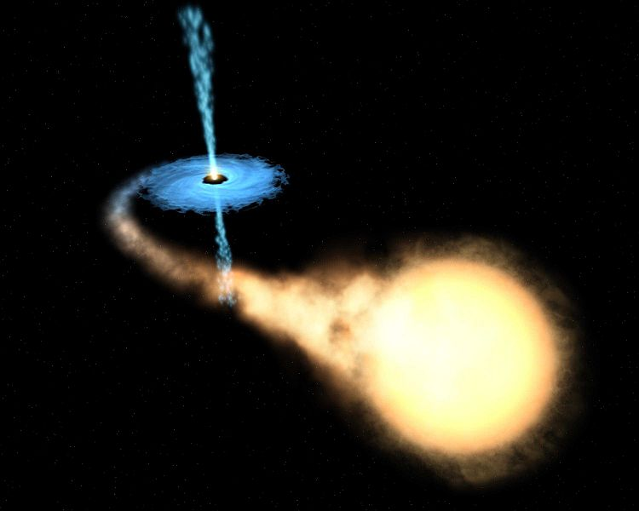
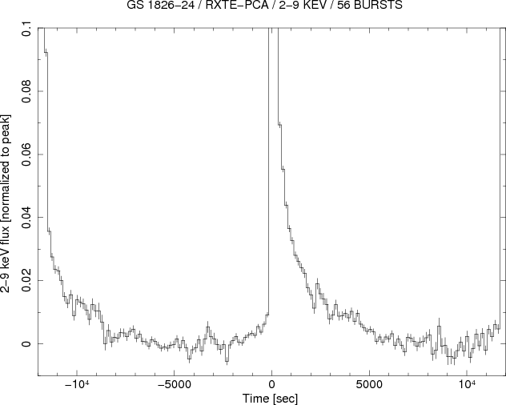
Breakout reactions
Bridge between HCNO cycle and rp-process
T₉ > 0.3, processing beyond CNO cycle after breakout via :
T₉ >~ 0.3 : ¹⁵O(α,γ)¹⁹Ne
T₉ >~ 0.6 : ¹⁸Ne(α,p)²¹Na
“ X-ray burst ”
A site for breakout to rp-process
3α flow
T₉ > 0.3, Breakout starts
Notes:
Trigger condition for x-ray bursts : 0.1 ~ 0.2 GK 10^6 ~ 10^7 g/cm^3, but IN NOVAE peak temperature 0.2 ~ 0.35 GK 500 ~ 5000 g/cm^3

Slide 7
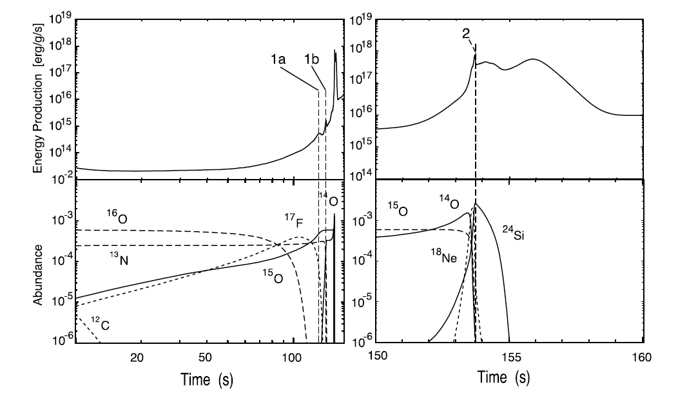
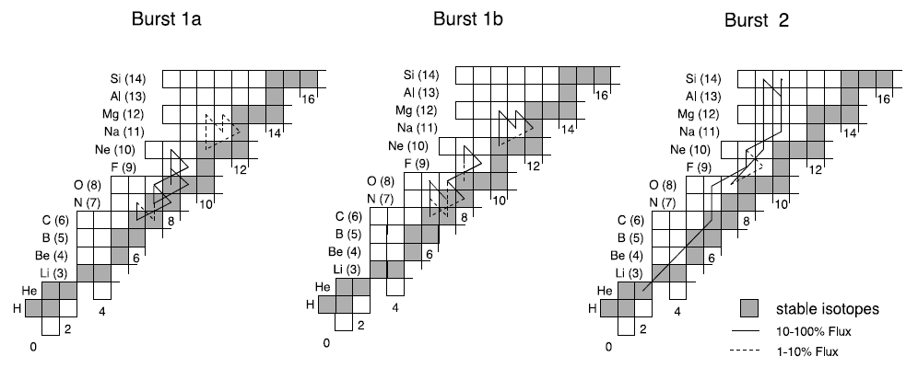
Energy spike shown in
X-ray bursts is due to
breakout and rp- process.
M. Wiescher, J. Gorres and H. Schatz

Slide 8
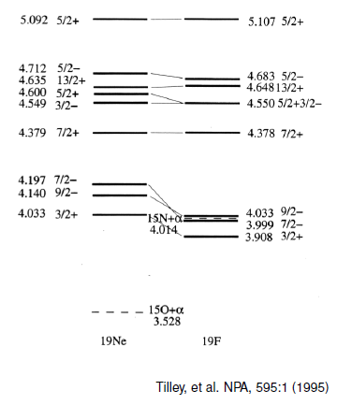

¹⁵O(α, γ)¹⁹Ne
In T₉ = 0.5 ~ 1.5, two resonances ( E_{x} = 4.033 and 4.379 MeV ), most likely to contribute to the reaction rate of ¹⁵O(a, g)¹⁹Ne. (c.f. ¹⁵O(g.s.) = 1/2⁻ )
High Coulomb barrier makes direct measurement difficult, especially in case of 4.033 MeV state, where a high intense ¹⁵O beam of ~ 10¹¹ pps is indispensable for a count rate of 1/hr.
Indirect measurement, only way for now !
Resonant reaction rates, proportional to
Gamow window : 0.5 ~ 2.0 MeV
→ 0.5 ~ 1.5 GK
E_{r} and J^{π} : previous studies
Γ_{α} (Γ_{T} ~ Γγ) : suggested study

Slide 9
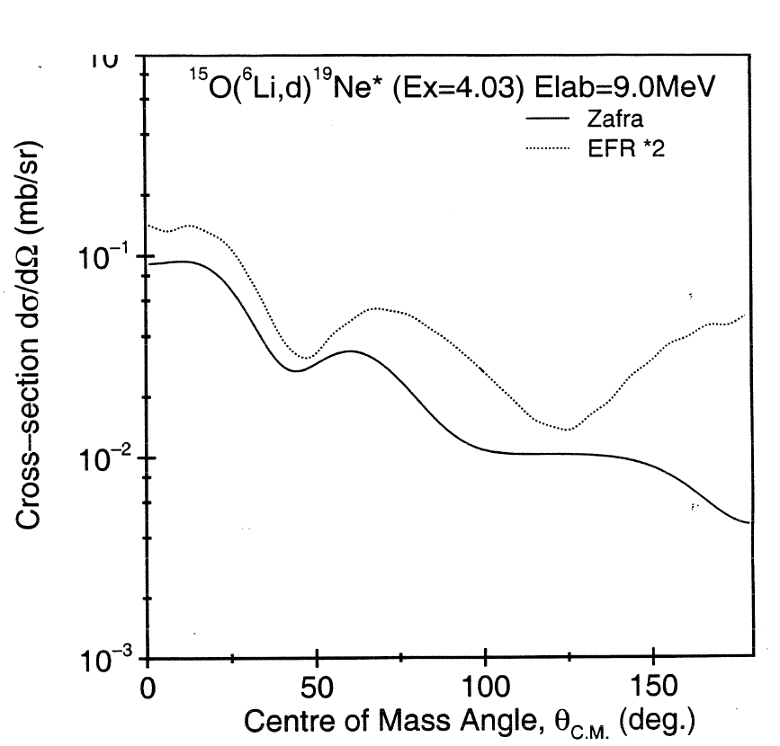
⁶Li(¹⁵O, d)¹⁹Ne
Alpha transfer cross section for extracting the partial width of states in ¹⁹Ne
(N : related to projectile and experimentally measured from some states whose spectroscopic
factors are already known)
Angular distribution measurement in inverse kinematics
For 4.033 MeV, the angular range to be measured is
19 ~ 69 deg in C.M.
( 79 ~ 142 deg. in Lab )

Slide 10
From the energies and angles of deuterons, Q-value spectrum is obtained.
Higher states
d
E_{d}
E_{15O}
θ
⁶Li
ψ
¹⁵O
0
Q - Q₀
Q₀ = 2.06 MeV
|Q - Q₀|= Ex
¹⁹Ne
To have spectra of better quality, three factors must be improved.
Higher intrinsic energy resolution,
Higher angular resolution
Lower energy spread of beam

Slide 11
A
The spread of 4.033-MeV peak
in Q-value spectrum is affected as shown.
Condition :
E(¹⁵O) = 5 MeV/u,
FWHM : the averaged value over 79 ~ 142 deg.
: Beam spread = 1%, Intrinsic resol. = 0.5 %
: Beam spread = 1%, Angular resol. = 1 deg.
: Angular resol. = 1 deg. Intrinsic resol. = 0.5 %
As expected, beam spread is most
contributing factor. So, lower and better.
B
C

Slide 12
In order to separate 4.033-MeV peak from 4.140-MeV peak,
appropriate angular resolution should be retained depending on the beam
energy spread. (See, the figure)
Condition :
Intrinsic resolution : 0.5 %
Combinations in the shade are giving rise
to smaller spread of less than 100 keV.
(c.f. Intrinsic energy resolution should be
< 0.75 %)
In case of ISOL beam of ¹⁵O, E/ΔE > 10⁴.
So, Angular resolution can be < 0.6 deg.
< 100 keV
That is, the strip size ( d ) of DSSD and
its distance ( L ) from the target center
should be determined as followed,
d/L = 0.6 deg. ~ 0.01047 rad

Slide 13
Dynamic range : 3 ~ 22 MeV
1364 μm - Si
19.7
g. s.
ΔE – E : 60 μm – 1500 μm ??
PID is necessary ???
Other
states
< 4.800 MeV
16.15
970 μm - Si
222 μm - Si
forward
6.74
4.54
116 μm - Si
Backward
Angle (deg.)

Slide 14
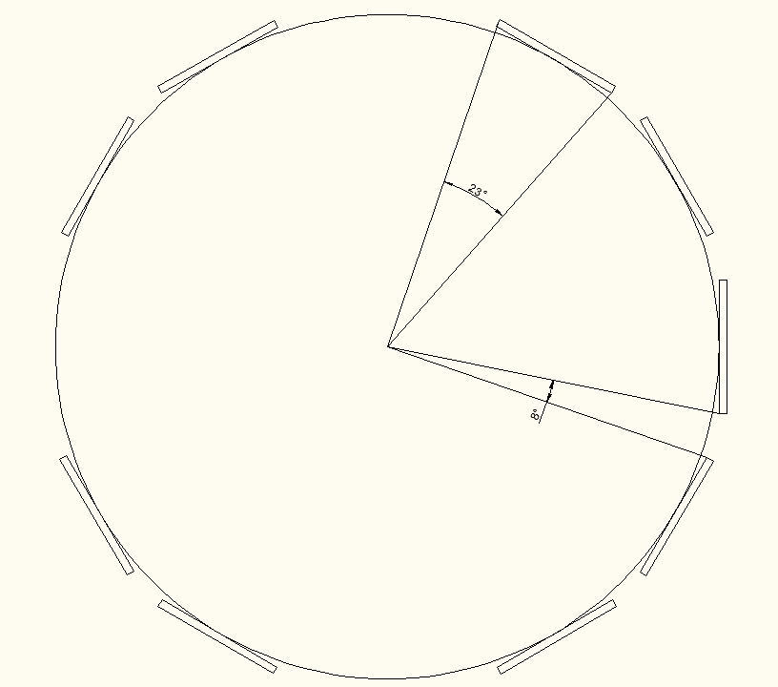
For a strip size ( d ) of 1mm, the distance ( L ) is 100 mm at 90 deg.
146 mm
100 mm
142 deg.
79 deg.
Beam
Target
Si-pad
Si-pad
40mm
Azimuthal angular coverage :
9 x 23 deg./360 deg. = 0.575 ~ 60 %
75 mm
No. of channels : 2 x 62 x 9 = 1116 channels
(SUPPER ORRUBA : 1.2 mm strip size, 75mm x 40 mm Si-PAD ; 2560 channels handled)
Signal processing → FPGA-based DSP, or ASIC ?

Slide 15
Summary
Silicon Array is very necessary for transfer reaction study.
Preliminary calculation has been performed for ⁶Li(¹⁵O, d)¹⁹Ne in order to
get basic geometries for Monte-Carlo simulation.
Angular coverage by array is
79 ~ 142 deg. in Lab.
To separate 4.033 MeV from neighbors, in case of ISOL beam of ¹⁵O,
Angular resolution : d/L = 0.6 deg. ~ 0.01047 rad
( SUPER ORRUBA : Angular resolution ~ 0.77 deg. @ 90 deg. )
ΔE-E telescope : 60 mm – 1500 mm
Background study, needed for checking out the necessity of PID
Monte-Carlo simulation → optimizing key parameters
To handle more than 1000 channels, ASIC ? or FPGA-based DSP ?

Slide 16
¹⁵O(α, γ)¹⁹Ne -> ⁶Li(¹⁵O, d)¹⁹Ne
¹³²Sn(d, p)¹³³Sn
N= 50 and ¹³²Sn region important to nuclear structure of nuclei in drip line
and r-process
SuperORRUBA (ORNL) very dedicated for the transfer reaction with n-rich RIB

Slide 17
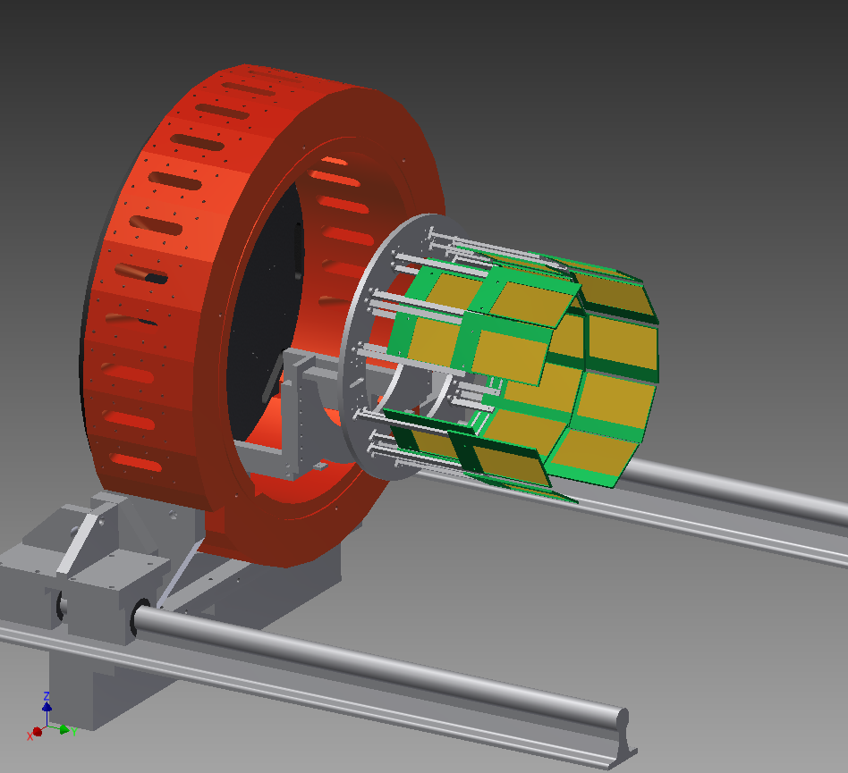
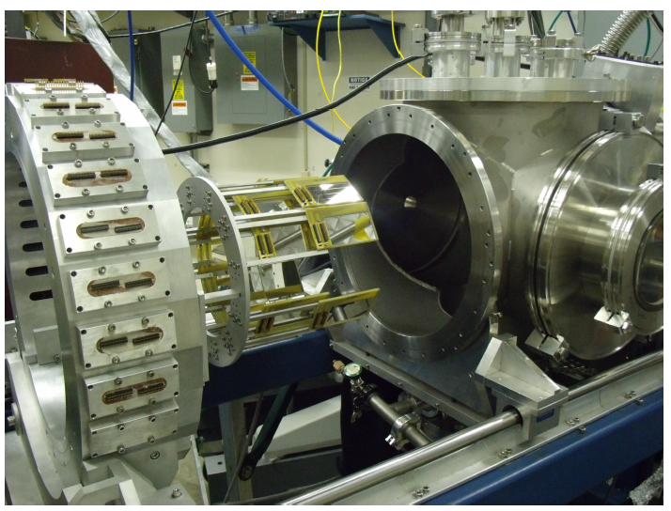
SuperORRUBA
Super Oak Ridge Rutgers Universal Barral Array
Angular coverage : 45 ~ 135 deg.
Azymuthal coverage : 60 % or 80%

Slide 18
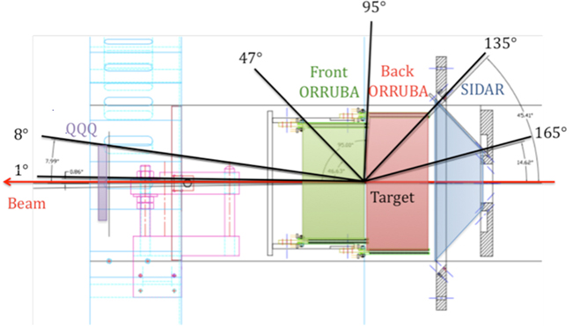
Front ORRUBA : 65μm-1000 μm Telescope (position sensitive)
Back ORRUBA : single layer of 1000 μm-thick position sensitive

Slide 19
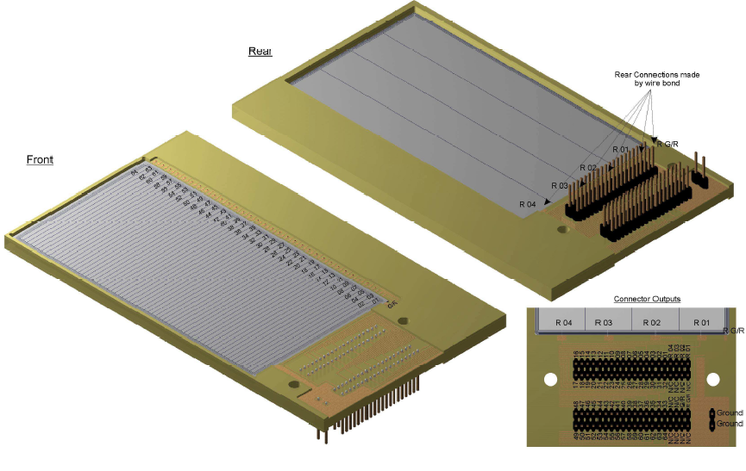
7.5 cm x 4cm,
1.2 mm pitch size

